Slide 1
Creating Servlet Application Using NetBeans

Slide 2
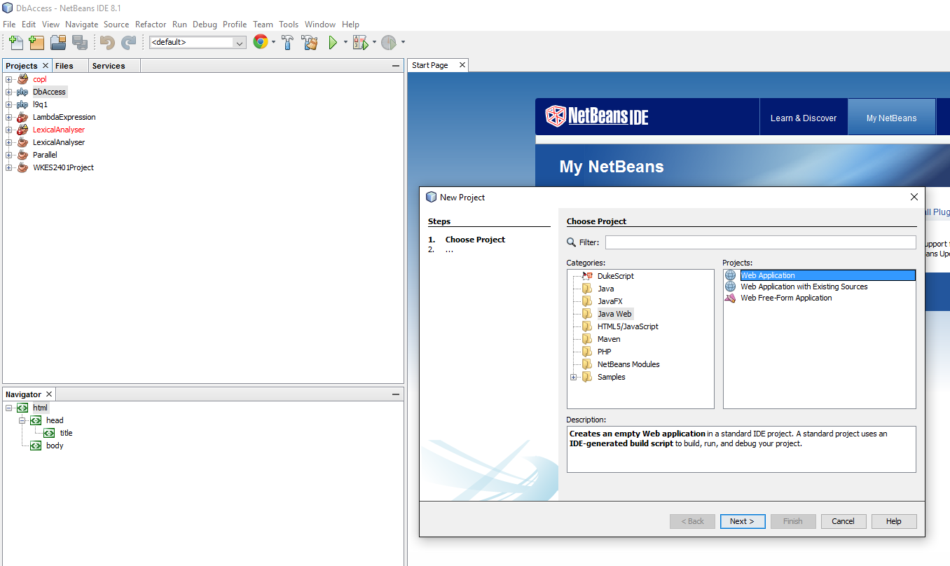
Create New Java Web Application

Slide 3
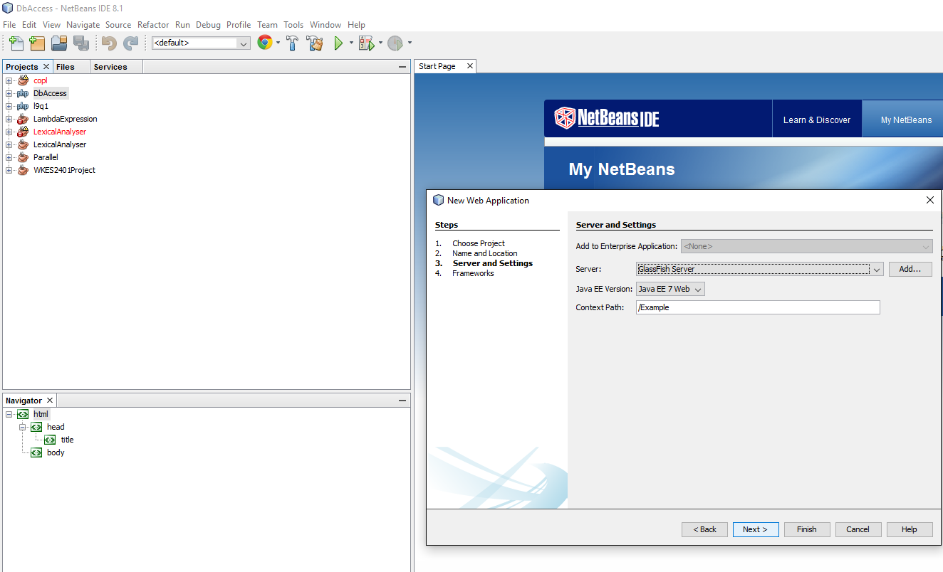
Name the Project and Select Server

Slide 4
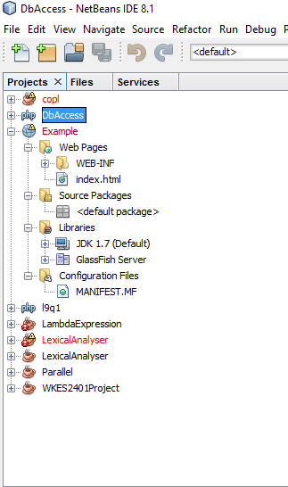
Directory Structure

Slide 5
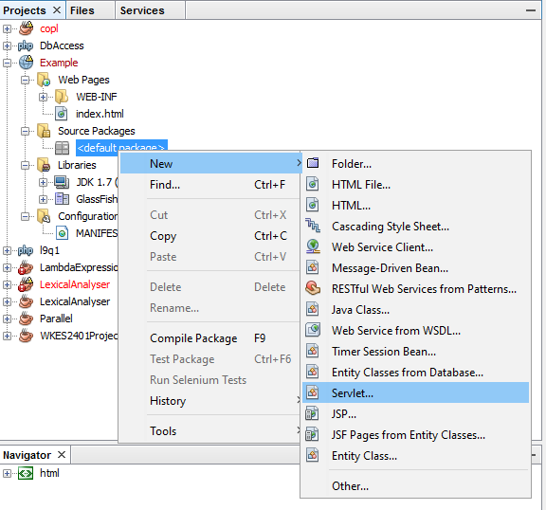
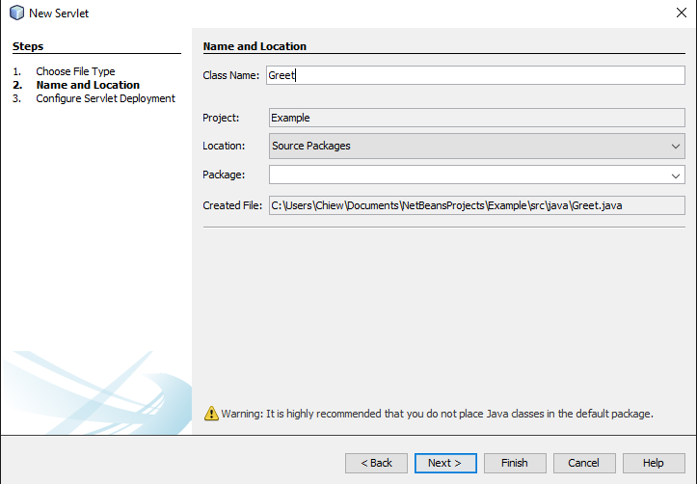
Create a Servlet
Open Sources Packages->right click <default package>New->Servlet

Slide 6
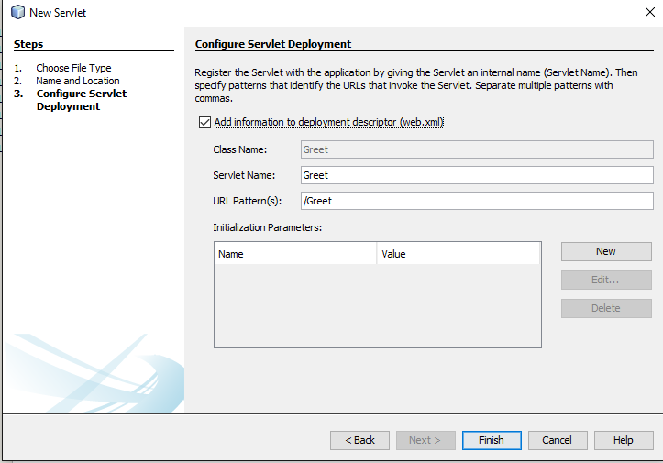
Configure Servlet Deployment
Add information to deployment descriptor (web.xml)

Slide 7
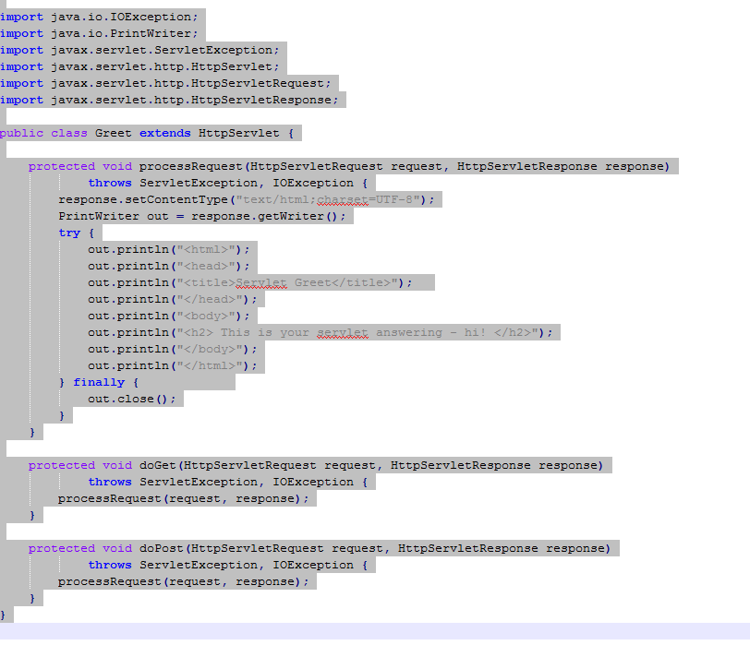
Write the Servlet

Slide 8
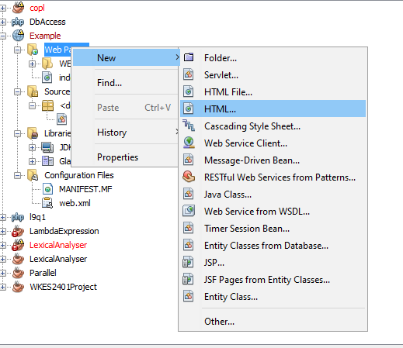
Create an HTML File
Right click Web Pages->New->HTML

Slide 9
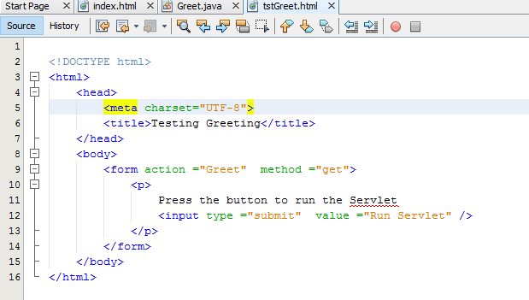
Write the HTML File

Slide 10
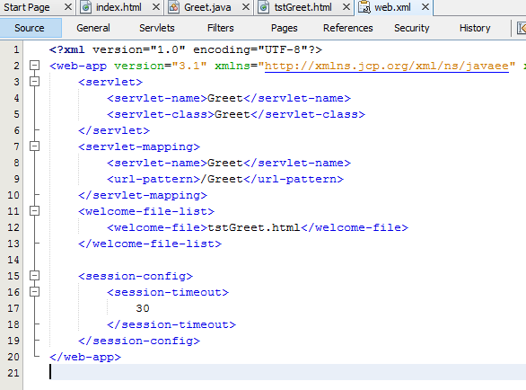
Edit web.xml

Slide 11
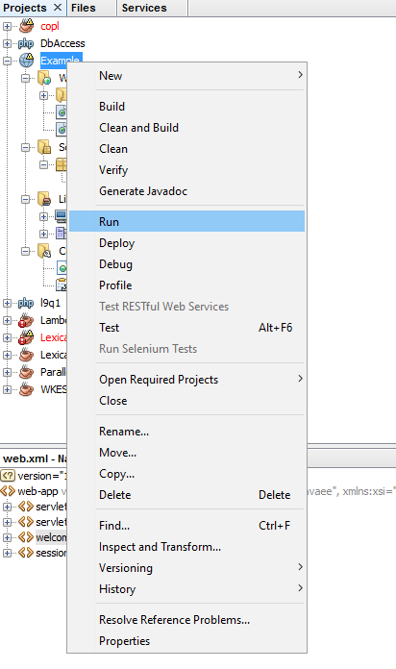
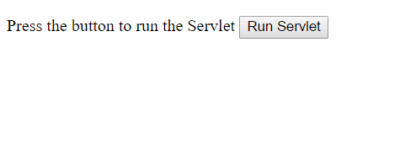
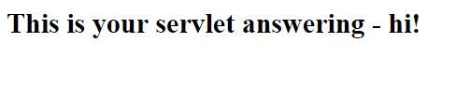
Run Application

